Slide 1
Membership Retention
Anthony Alvarez, Mark Levine, Janette Bennett

Slide 2
Project Background
A weight loss company would like to know if any indicators exist that would indicate future patient “churn”.
The weight loss company maintains EMR records in a SQL database that captures patient demographic and treatment data.
Going forward, the weight loss company would like a weekly report of patients that are most likely to “churn”.
From this report, the weight loss company would like to create proactive patient interventions to minimize “churn” and improve patient satisfaction.

Slide 3
About the Company
The weight loss company has been in existence since the early 1970’s.
In 2015, the company was acquired by a private equity company from the family ownership.
As a result, there is a new executive leadership team whose main goal is to create new revenue streams and increase profitability.
The ultimate goal is to sell the company to another investor within the next 24 months.

Slide 4
About the Subscription Model
In January 2018, the weight loss company moved to a subscription model for patients.
Previously, weight loss programs were purchased in 4, 6, and 10 week increments.
In the subscription model, patients select a plan and automatic payments are made by credit card, or patients pay in full.
The first 12 months are guaranteed by contract. At the start of the 13th month, patients are “month to month” and can cancel at anytime.

Slide 5
Project Plan
Create Hypothesis for solving Problem
Pull data from SQL Database
Clean Data (hide and create alternative Patient ID for HIPAA compliance)
Modify Data using Pandas
Create Machine Learning Algorithm for training and testing of data
Create visualization in Power Bi to determine data trends for management
Review findings to answer Hypothesis

Slide 6
Hypothesis
In a dataset of over 10,000 subscribers to a monthly weight loss program, is there a correlation between:
Number of Visits
Weight Loss
Payment History
From this analysis, we can also determine if a trend exists among patient subscribers who have canceled subscriptions that can be directed to reduce patient churn and improve retention.

Slide 7
Definition of “Churn”
We define “churn” as any membership subscription that is canceled prior to the 12 month term and/or has not had a visit within a 3 month span.
We need to reduce “churn” to ensure future revenue streams as well as improve patient outcomes and “word of mouth” patient success.

Slide 8
Data Sets & Challenges
Company SQL database
Credit Card Processing data from Square and Stripe
Square and Stripe are credit card processing companies that enable automatic payment via subscription.
Due to the nature of the medical information and HIPAA, removing data and masking certain fields created some challenges.
Due to the age of the EMR system, the data contained null values, invalid characters, blank lines, variant encoding types, etc.

Slide 9
Programs Used
M.L. with caret library (R)
Python
SQL
Power BI
R Dplyr & GGplot2
Plotly
Numpy
Pandas
MatPlotlib
Jupyter Notebook

Slide 10
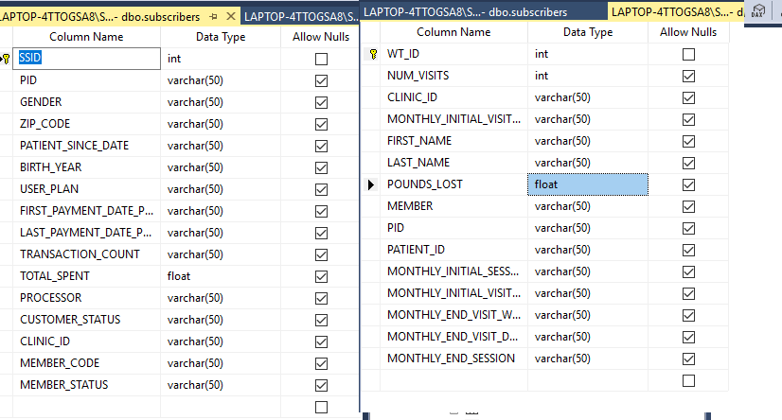
Data Structure

Slide 11
Machine Learning
Define Purpose
Wrangling / Cleaning
Visualizations
Prep and Fit Models
Assess Accuracy
Communicate Results

Slide 12

Machine Learning Markdown File
https://github.com/MarkovCredit/FinalPush_Churn/blob/master/FinalFiles_R/R_Wrangling_Modeling.md

Slide 13
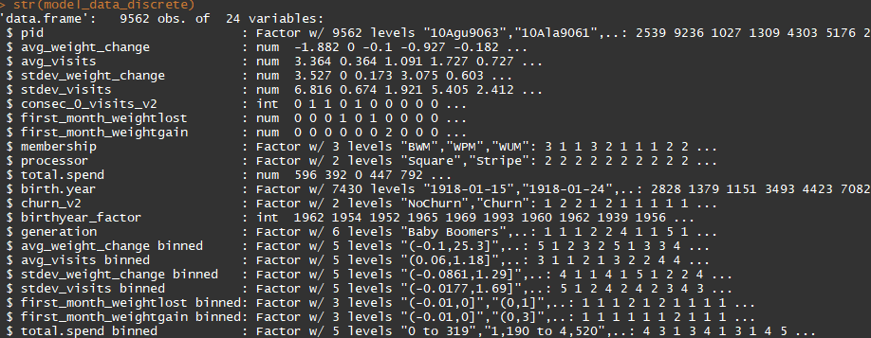
Variable Structure

Slide 14
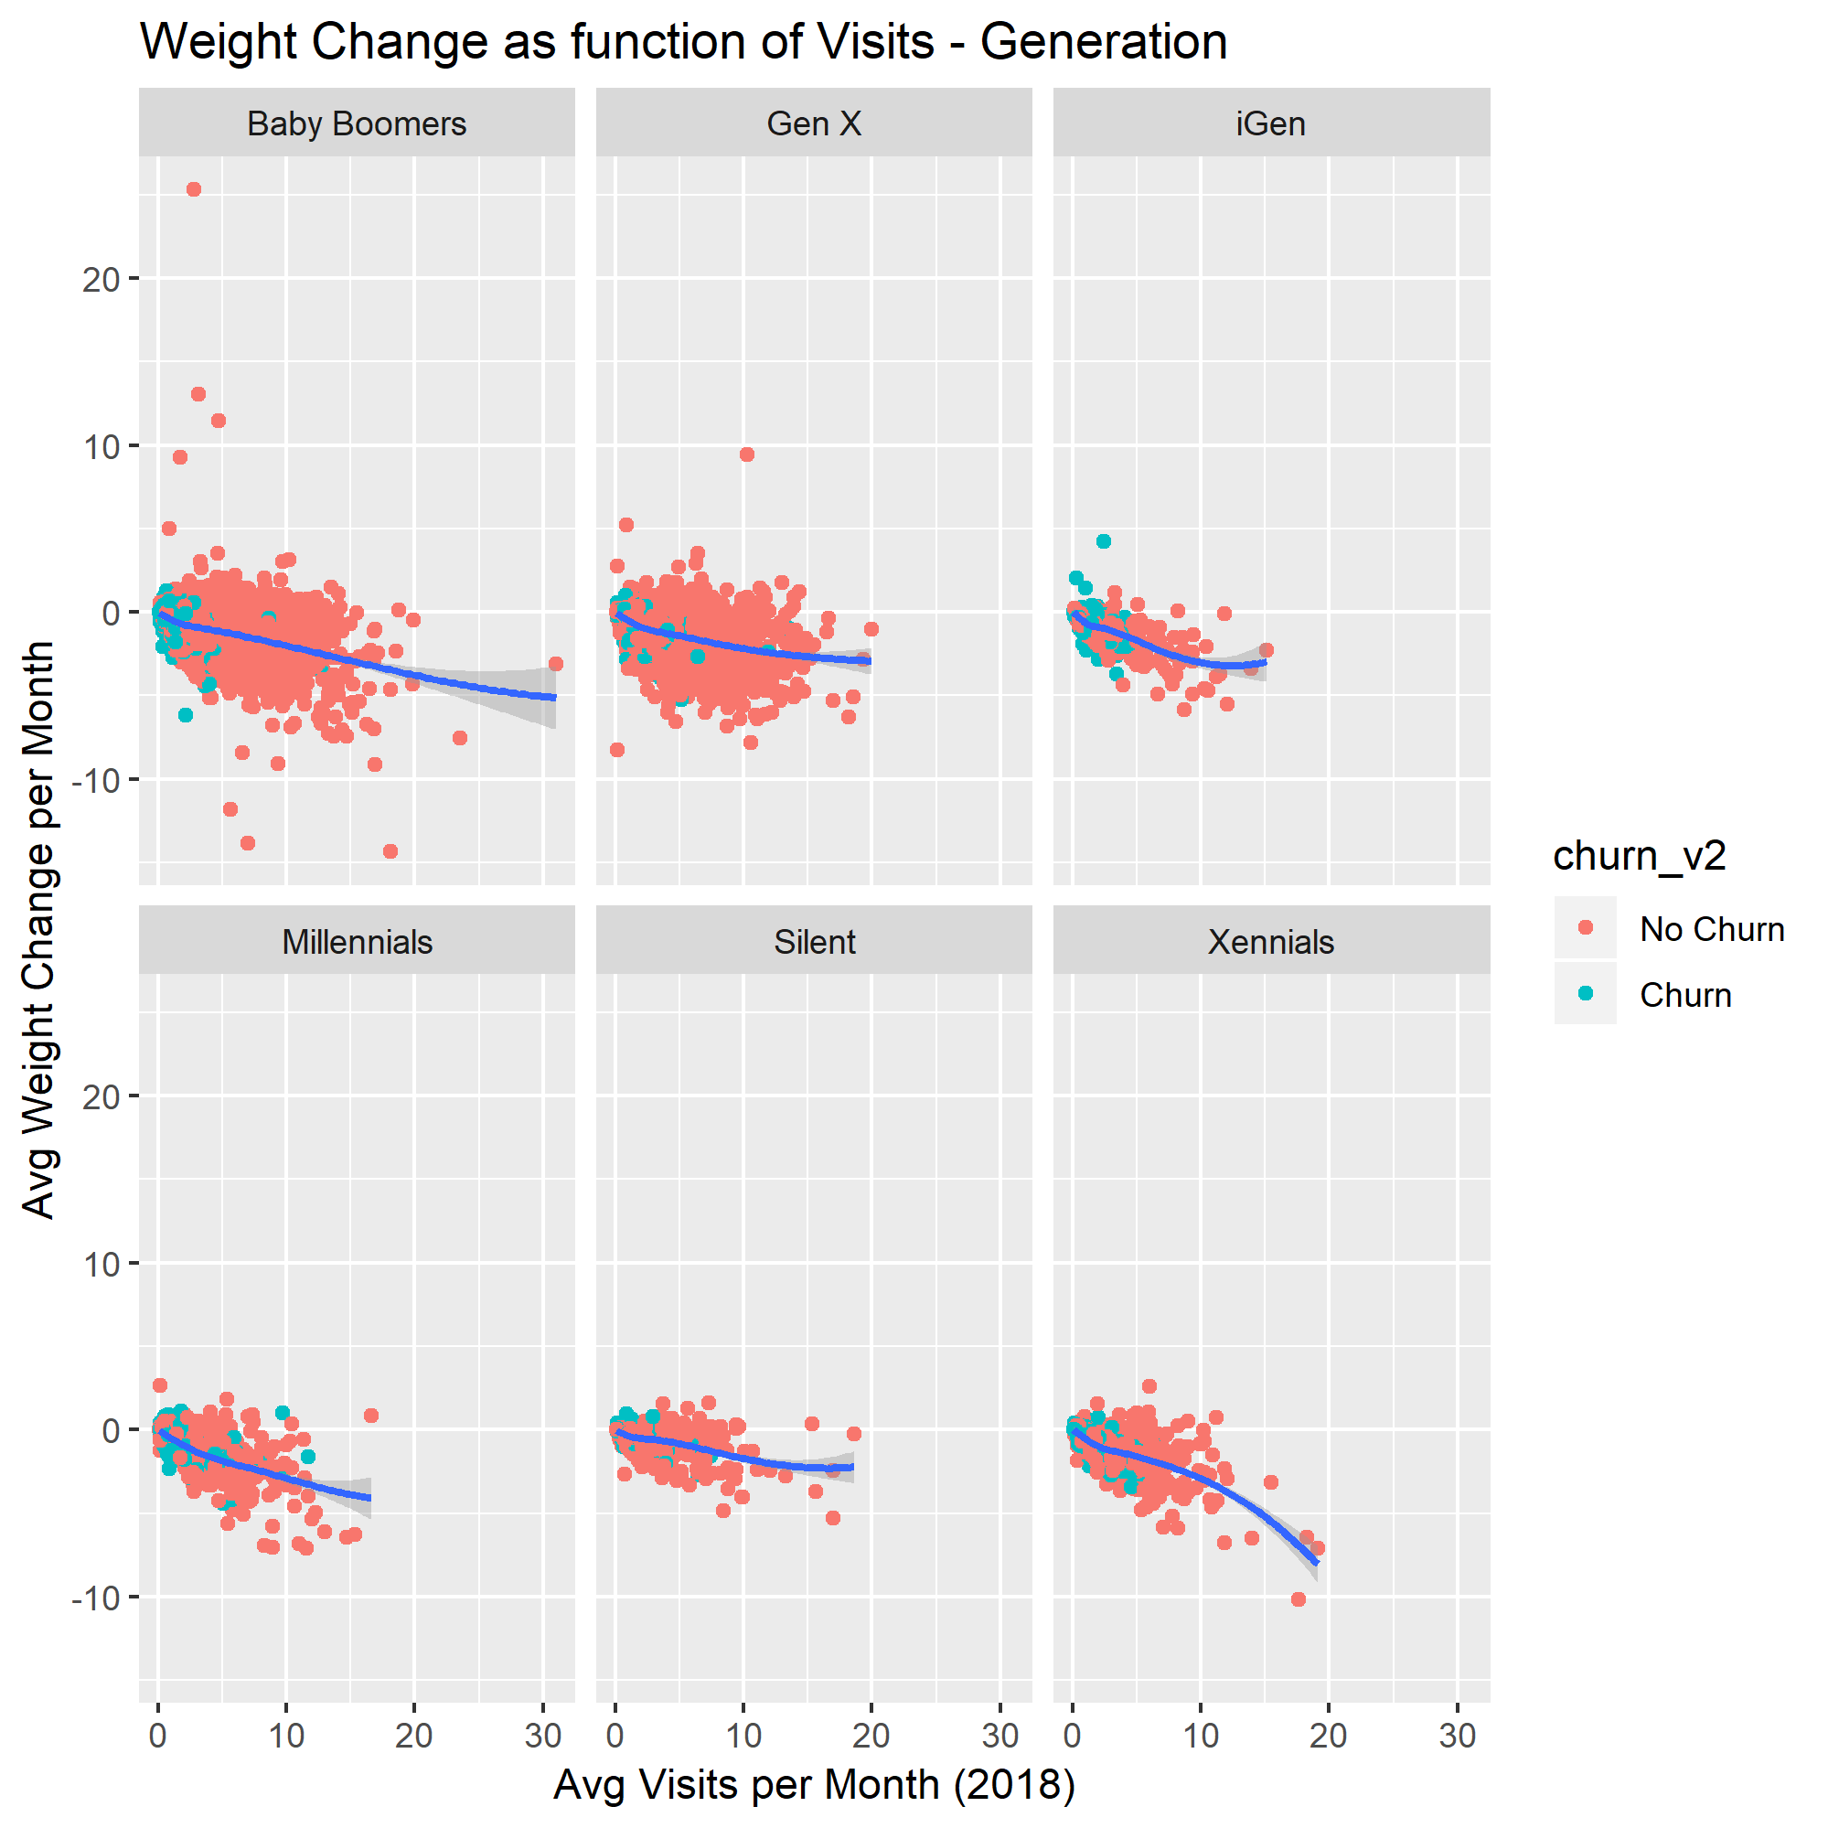
Visualizations: Visits x Weight Change by Generation

Slide 15
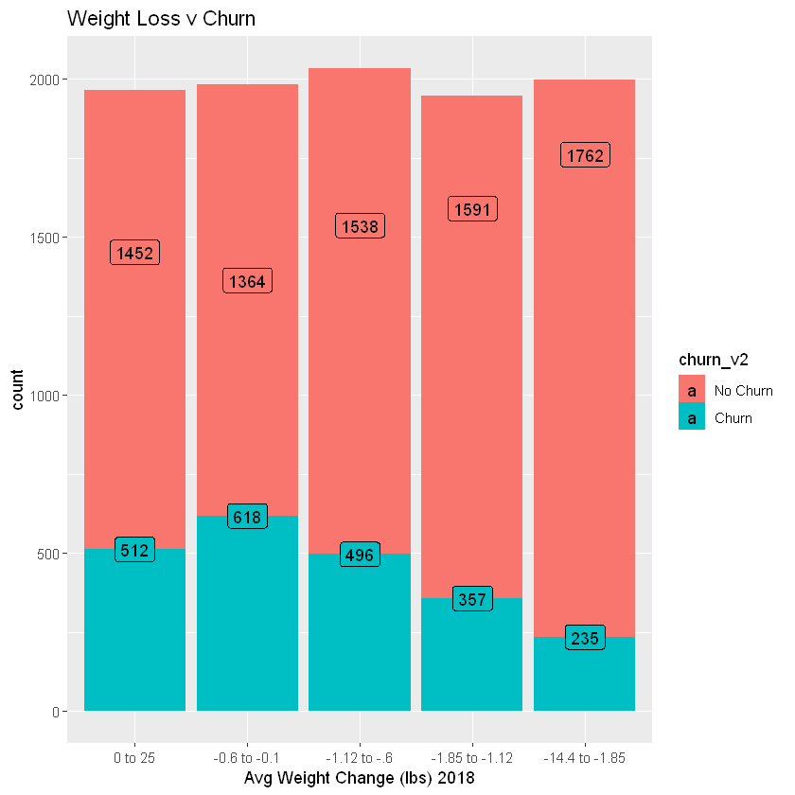
Visualizations: Avg Weight Change vs Churn

Slide 16
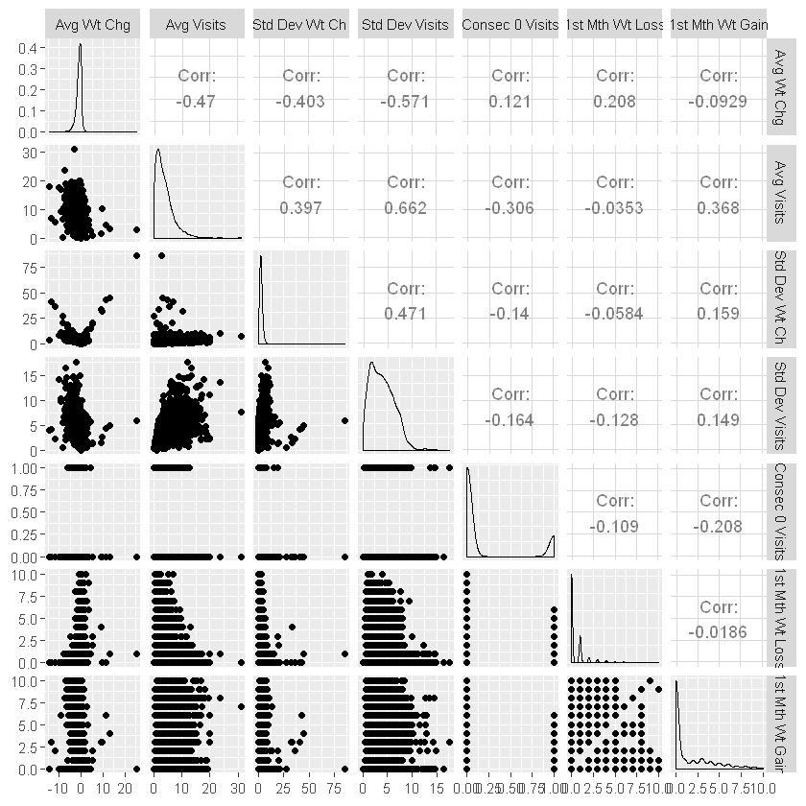
Visualizations: Pair Plot

Slide 17
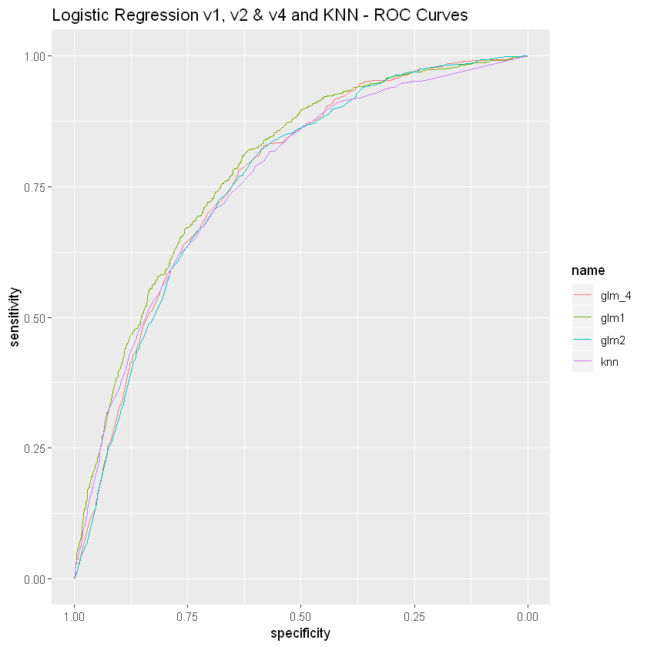
Model Validation

Slide 18
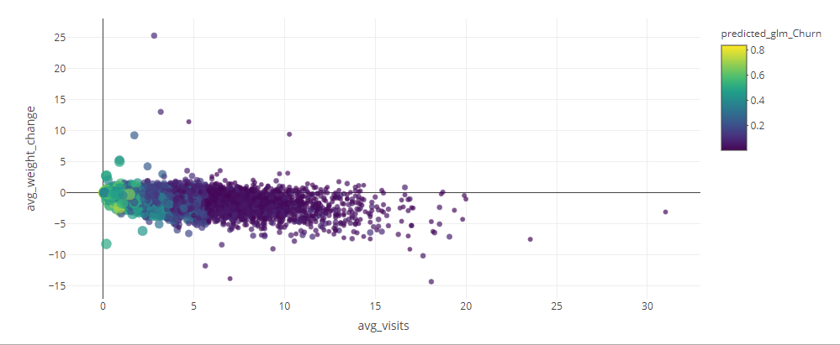
Visualize Predictions: Weight Loss vs Visits

Slide 19

Power Bi
For Management
https://app.powerbi.com/groups/me/reports/d39f9e2c-41e6-4877-916f-bf25a1002faf/ReportSection

Slide 20
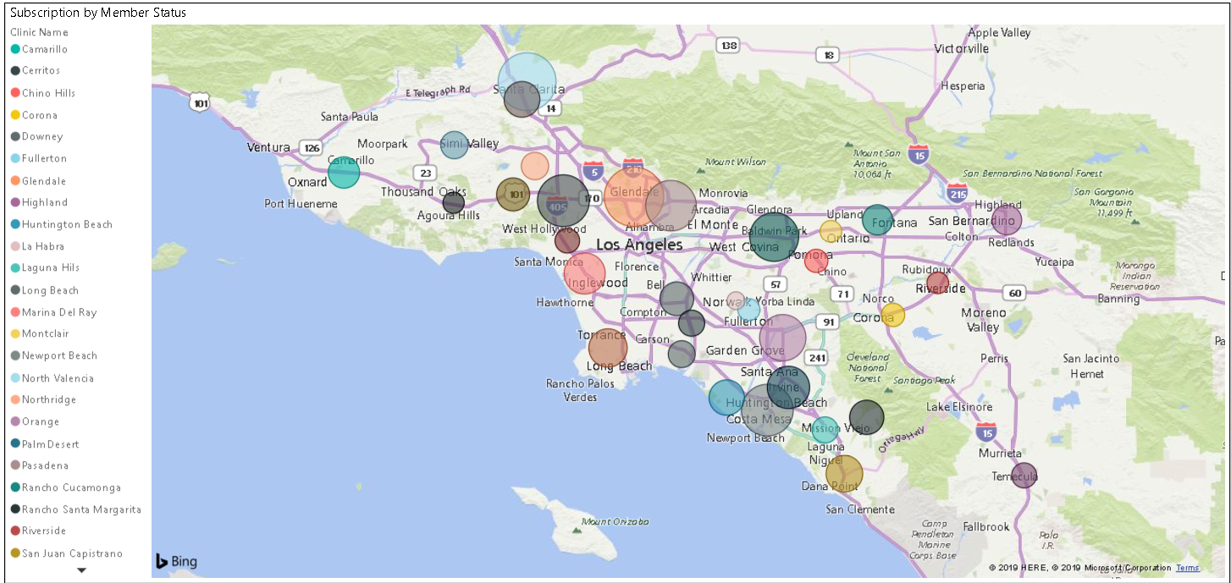
Subscription by Location and Member Status

Slide 21
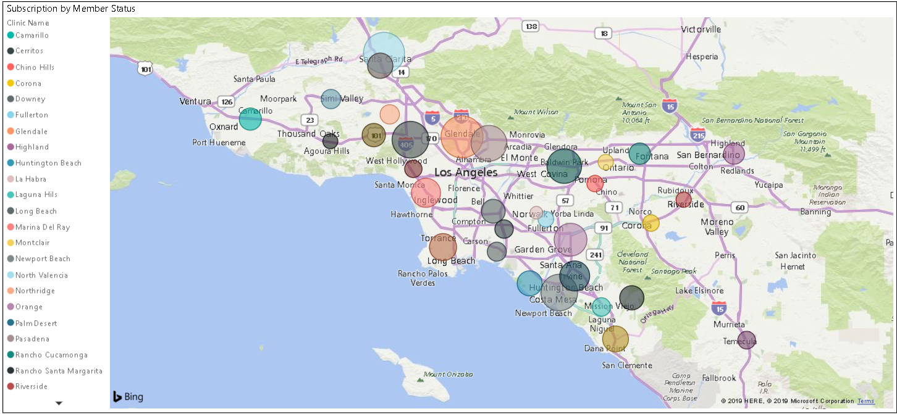
Subscription by Location and Gender

Slide 22
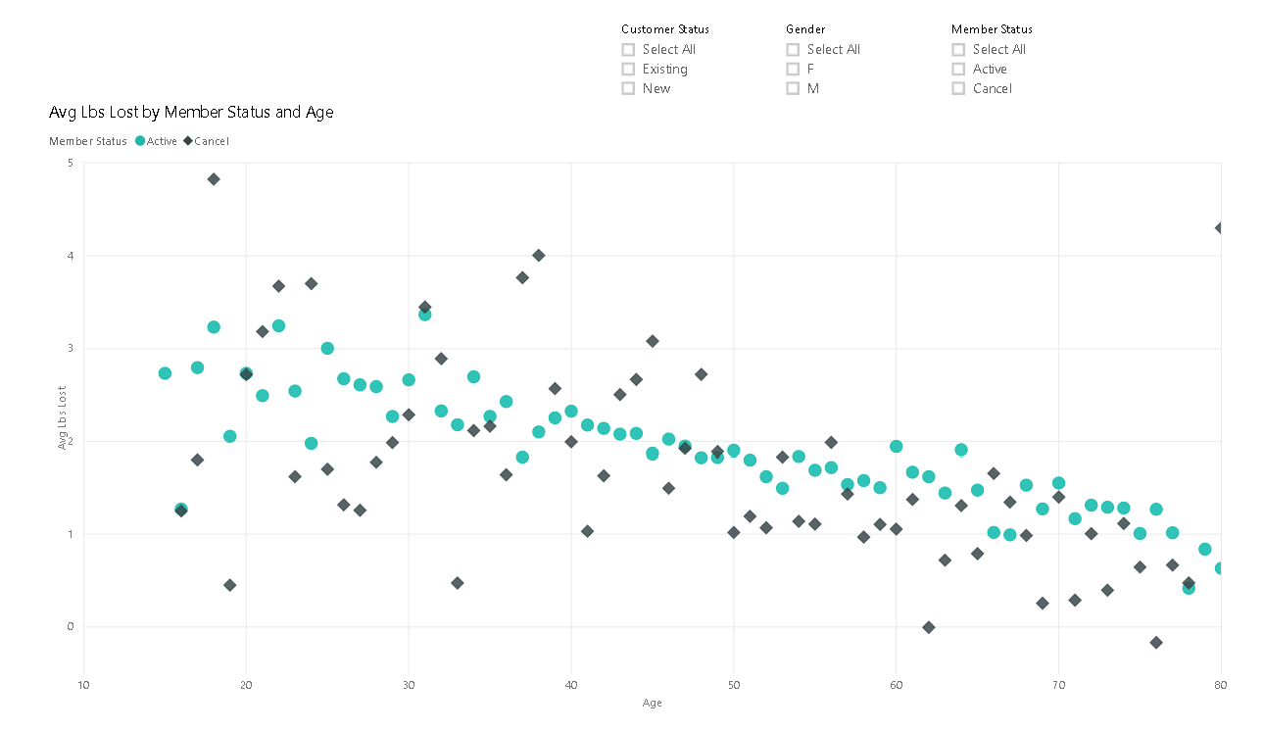
Is there a relationship Avg Lbs. Lost and Member Status by Age?

Slide 23
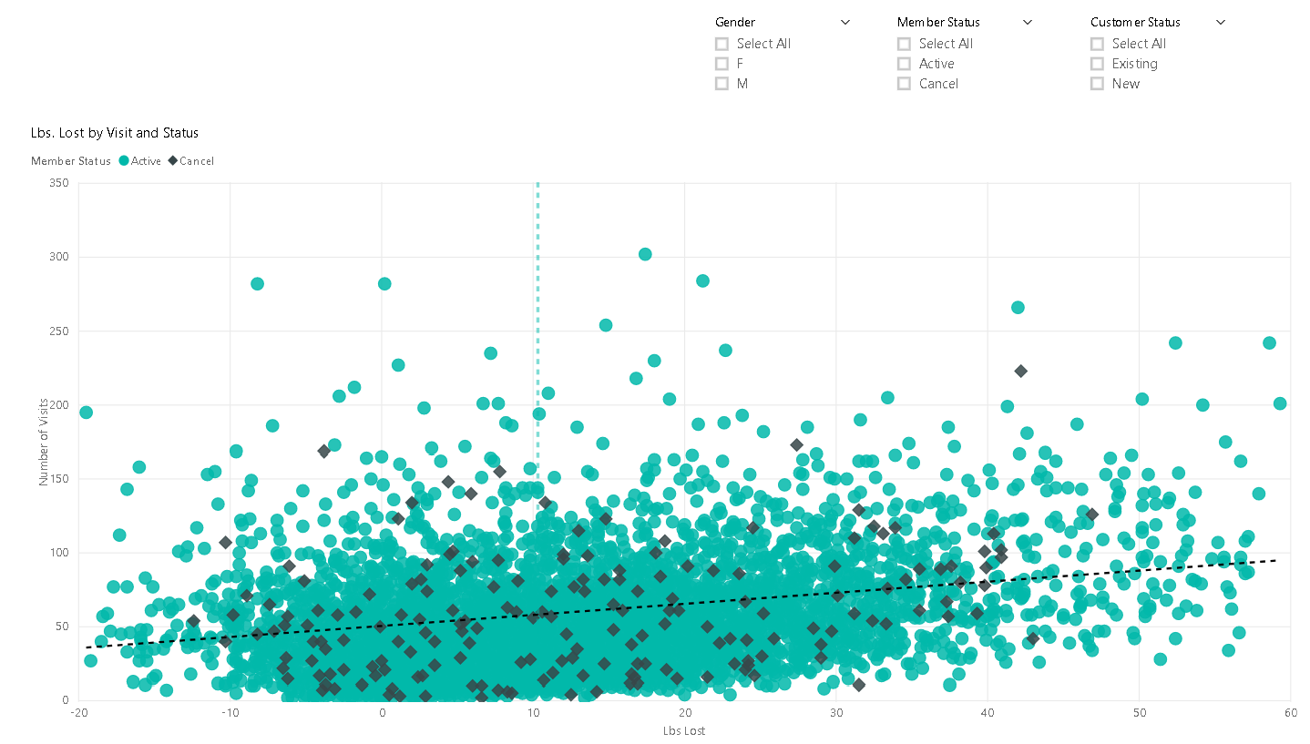
Lbs. Lost by Visit and Status

Slide 24
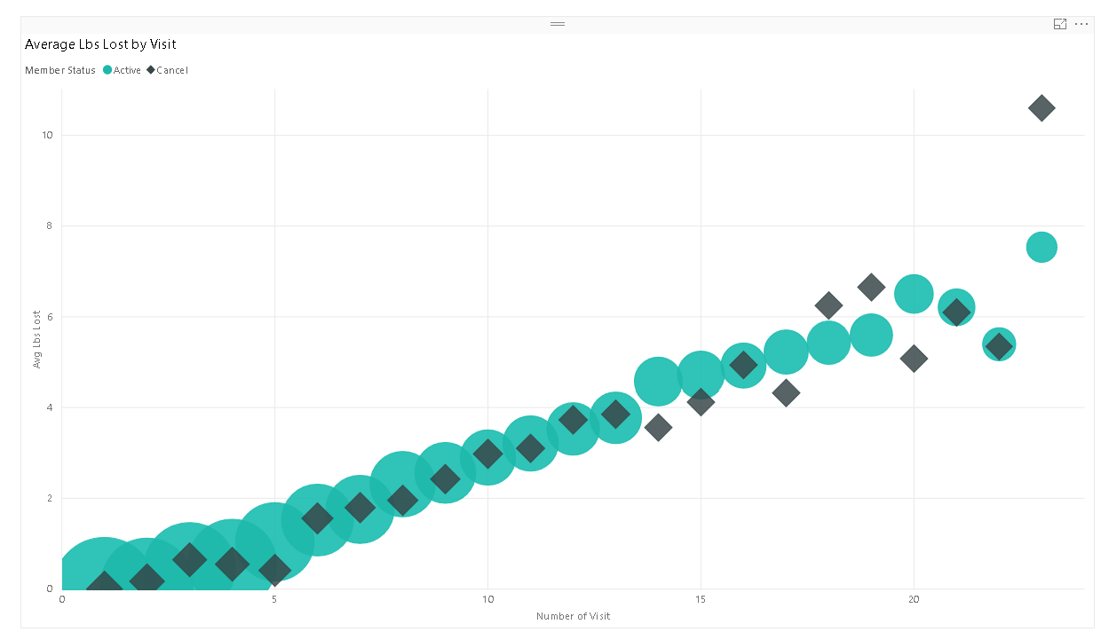
Is there a relationship between number of visits and lbs. lost?

Slide 25
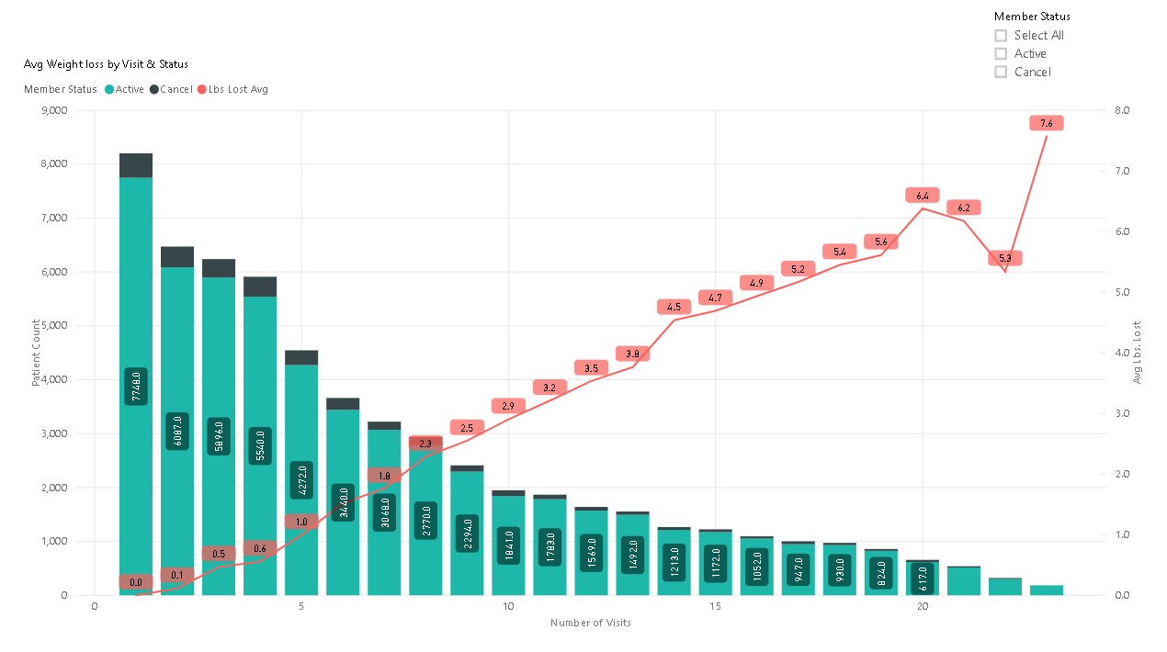
Is there a relationship between number of visits and member status?

Slide 26
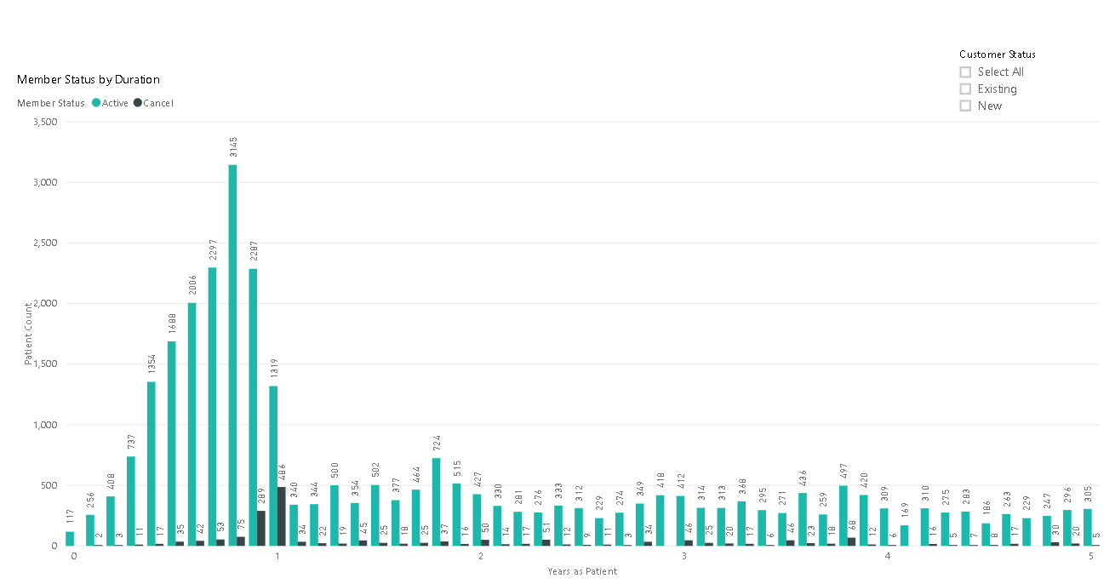
Does a relationship exist between duration of patient relationship to company and member status?

Slide 27
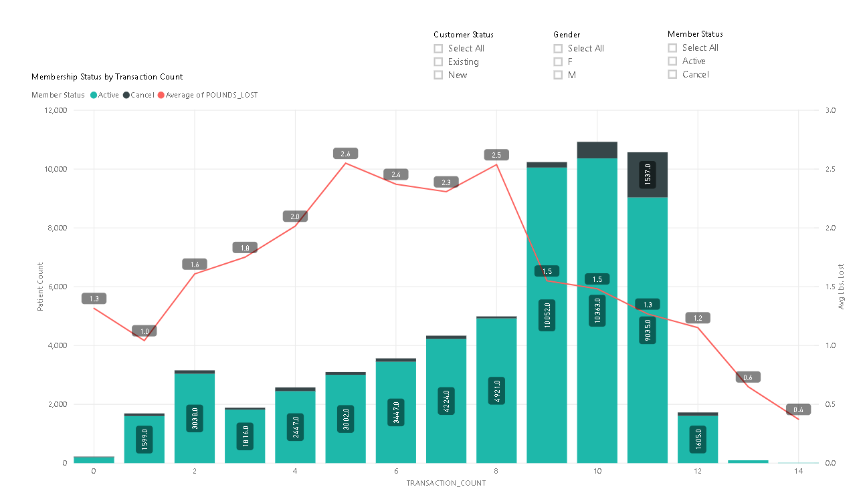
Is there a relationship between payment history and membership status?

Slide 28
Which factors are the best indicators of patient churn?
Weight Loss
Patients who lose less than 1 lb. after 5 visits are more apt to cancel.
Visits
Patients who visit less tend to lose less weight and are unlikely to continue.
History with Lindora
Patients with more than a year of history with Lindora are more likely to cancel.
Payment History
Patients who are nearing the end of the subscription period are more likely to cancel.

Slide 29
Which factors are not as significant indicators of patient churn?
Gender
There is no significant difference between gender in churn; although there is a significantly a higher number of female patients than male.
Age
Age is a moderate indicator of patient churn. Millennials tend to churn due to economic considerations and achieving weight loss goals.

Slide 30
Opportune Intervention to Reduce Churn
If a patient has not lost a lbs in the first 5 visits, an intervention needs to occur to address weight loss concerns.
2 months prior to subscription ending, an intervention to incentivize continued membership to appeal to patient.
Keep Xennials engaged after weight loss goals are met or with other incentives
Keep existing patients satisfied with weight loss under new subscription model vs. program model.

Slide 31
The “Unknown” Factors
How important are the visit interactions between patient and nurse in determining weight loss and number of visits.
Does the subscription model provide the outcomes and patient satisfaction that provide revenue?
How do operational policies impact patient satisfaction for maintaining a subscription model?
Are there factors in the patient’s history prior to starting the Subscription that could be an indicator of Churn?

Slide 32
Conclusion
There is a strong correlation between number of visits, weight loss, and churn.
The Management Team has developed a “premier” status for subscribers who reach the 13th month and continue to month-to-month payments.
However, as this data suggests, the Management team may want to review patients who are not losing weight in the first 5 visits and the satisfaction of existing patients.
The decision to cancel may come well before the 11th the month, thereby negating benefit of premier status.

Slide 33
Thank you.
For more information regarding our project, please visit our github page.

